Slide 1
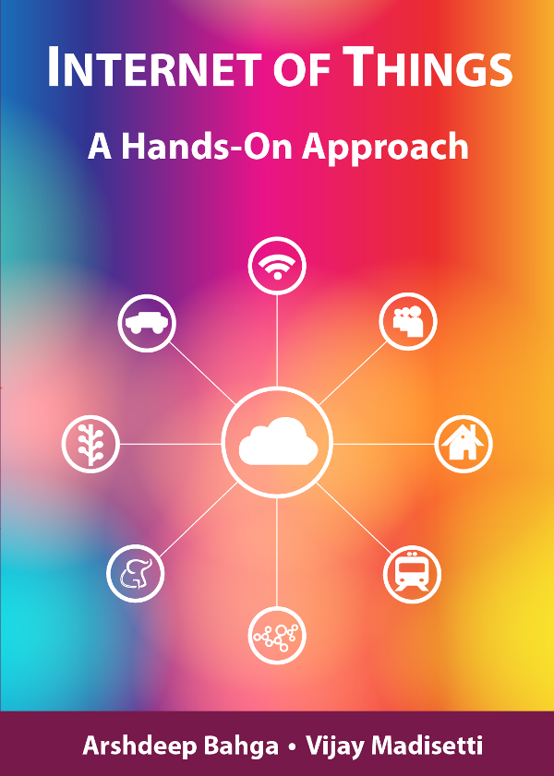
Introduction to IoT
By. Chandramouli Haldar

Slide 2
Deﬁnition of IoT
❖ The Internet of Things is the network of physical objects or "things" embedded with electronics, software and sensors, in a network connectivity, which enables these objects to collect and exchange data.
❖ It allows objects to be sensed and controlled remotely across existing network infrastructure, creating opportunities for more direct integration between the physical world and computer-based systems, and resulting in improved efficiency, accuracy and economic benefit.

Slide 3
Characteristics of IoT
⚙️ 1. Dynamic and Self-Adapting
IoT devices can respond to changes in the environment automatically.
Example: A smart light turns on when it senses someone entering the room
🔧 2. Self-Configuring
Devices can set themselves up with minimal or no human help.
Example: A smart plug connects to your network and starts working instantly.
🔗 3. Interoperable Communication Protocols
Devices can talk to each other even if they are made by different companies.
Uses standard communication methods like MQTT, CoAP, HTTP.

Slide 4
Characteristics of IoT
🆔 4. Unique Identity
Every IoT device has a unique ID to be recognized in a network.
Ensures secure and accurate data sharing.
🌐 5. Integrated into the Information Network
IoT devices are part of a larger digital ecosystem.
They connect to the internet and share data with cloud systems, apps, and other devices.

Slide 5
Evolution of IoT
📜 History of IoT
The concept of the Internet of Things (IoT) was first introduced in 1999 at the Auto-ID Center of MIT (Massachusetts Institute of Technology).
At that time, Radio-frequency identification (RFID) was seen as a prerequisite for the IoT at that point. If all objects and people in daily life were equipped with identifiers, computers could manage and inventory them. Besides using RFID, the tagging of things may be achieved through such technologies as near field communication, barcodes, QR codes, blue-tooth, and digital watermarking
🌐 Present-Day IoT
Today, IoT is everywhere—in homes, industries, vehicles, hospitals, and cities.
Devices are connected using Wi-Fi, 5G, LoRa, Zigbee, and other communication methods.
Data from sensors is sent to cloud platforms or edge devices for processing and decision-making.
Artificial Intelligence (AI) and Big Data now play a major role in making IoT systems smarter.
Over 15 billion IoT devices are active globally (and growing fast!)

Slide 6
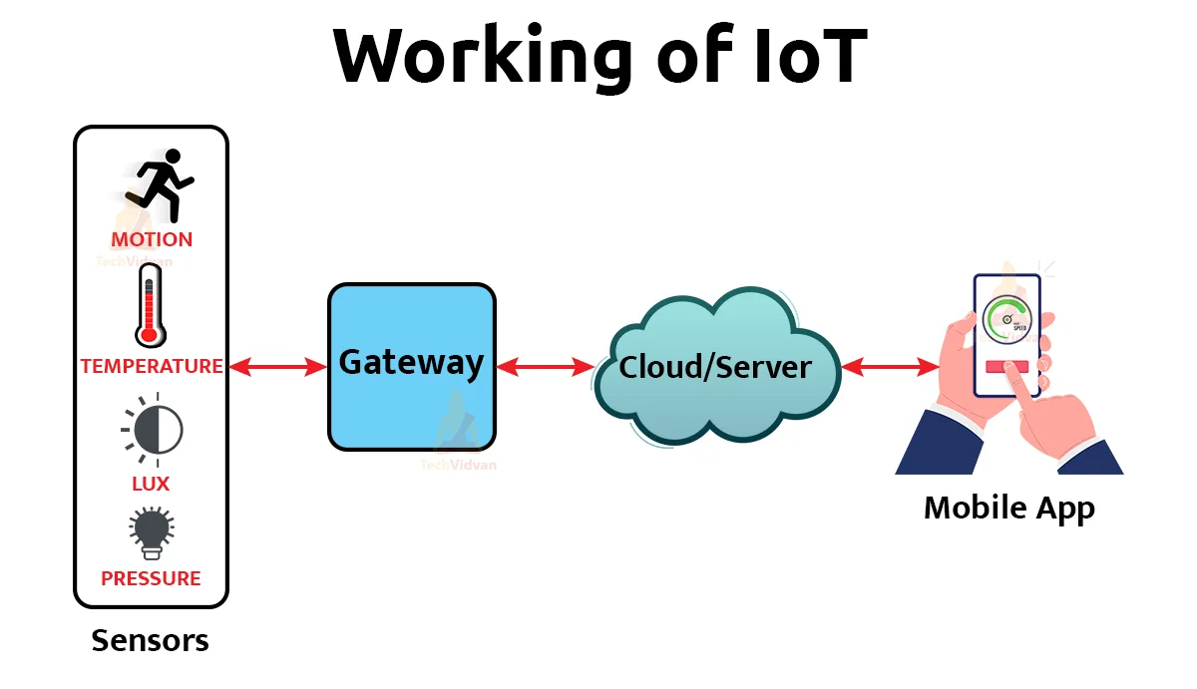
How IoT Systems Works
Sensors / Devices
Collect data from the environment
Example: Temperature, motion, light, GPS
Connectivity
Sends data to the cloud or other devices
Example: Wi-Fi, Bluetooth, LoRa, 5G
Data Processing
The cloud or a local device processes the data
Example: Checking if temperature is too high
Action / Output
A response is triggered based on the data
Example: Send alert, turn on fan, or display info in an app

Slide 7
Physical Design of IoT
The "Things" in IoT usually refers to IoT devices which have unique identities and can perform remote sensing and actuating and have monitoring capabilities.
IoT devices can:
Exchange data with other connected devices and applications (directly or indirectly), or
Collect data from other devices and process the data locally, or
Send the data to centralized servers or cloud-based application back-ends for processing the data, or
Perform some tasks locally and other tasks within the IoT infrastructure, based on temporal and space constraints

Slide 8
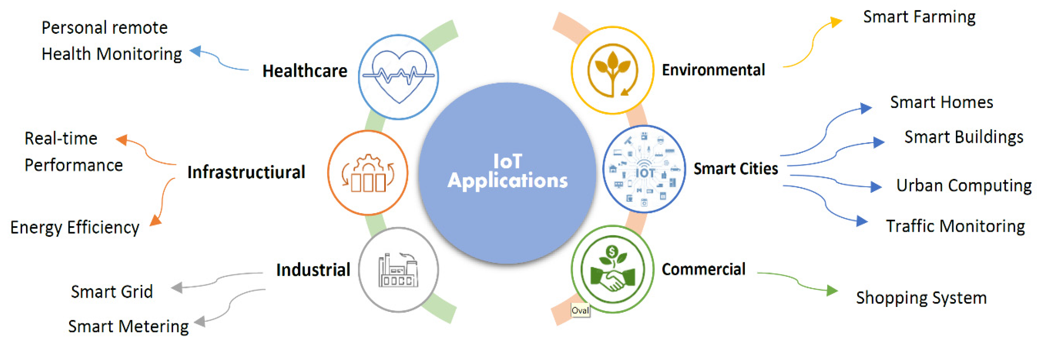
Applications of IoT

Slide 9
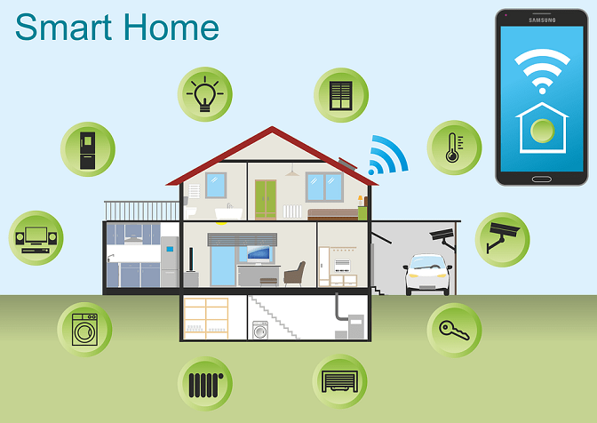
How IoT Systems Works Example

Slide 10
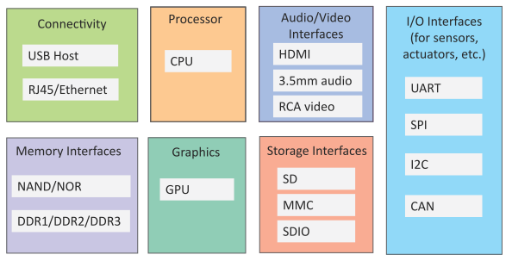
Generic Components of an IoT Device
An IoT device may consist of several interfaces for connections to other devices, both wired and wireless.
I/O interfaces for sensors
Interfaces for internet connectivity
Memory and storage interfaces
Audio/video interfaces

Slide 11
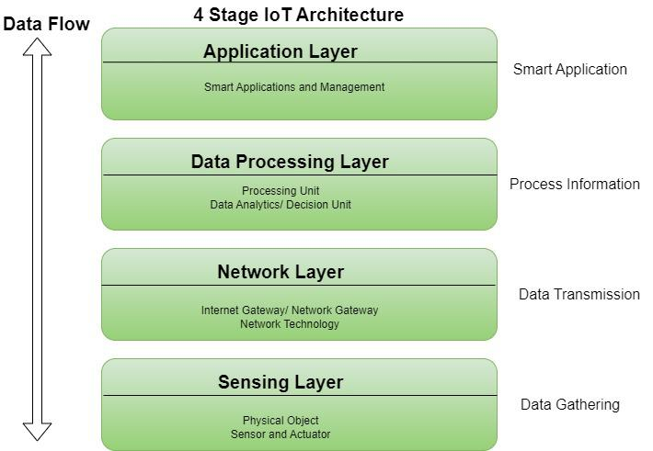
4 Stages of IoT Architecture

Slide 12
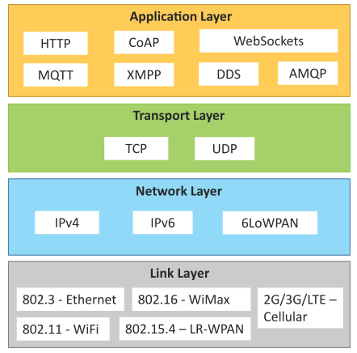
IoT Protocols
Link Layer
802.3 – Ethernet
802.11 – WiFi
802.16 – WiMax
802.15.4 – LR-WPAN
2G/3G/4G
Network/Internet Layer
IPv4
IPv6
6LoWPAN
Transport Layer
TCP
UDP
Application Layer
HTTP
CoAP
WebSocket
MQTT
XMPP
DDS
AMQP

Slide 13
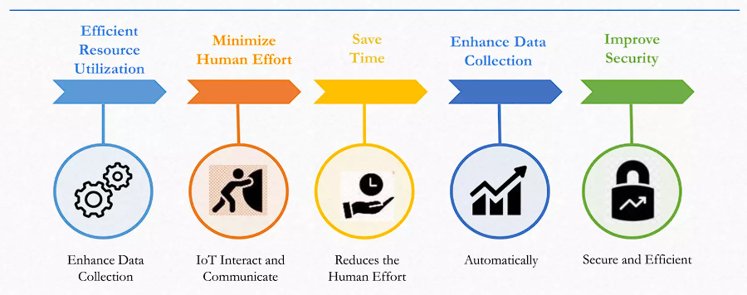
Advantages of IoT

Slide 14
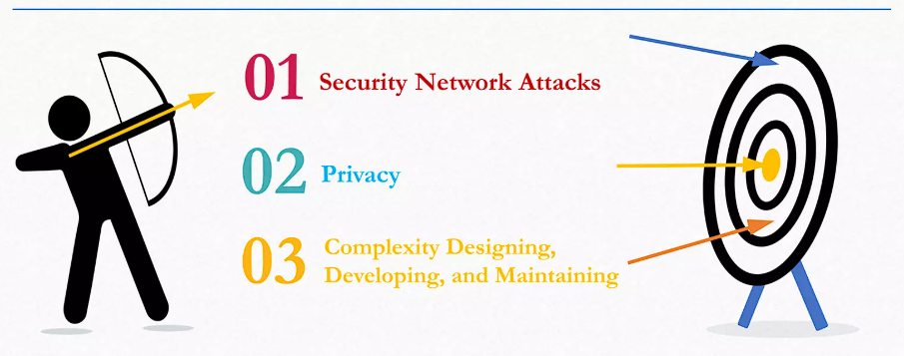
Disadvantages of IoT

Slide 15
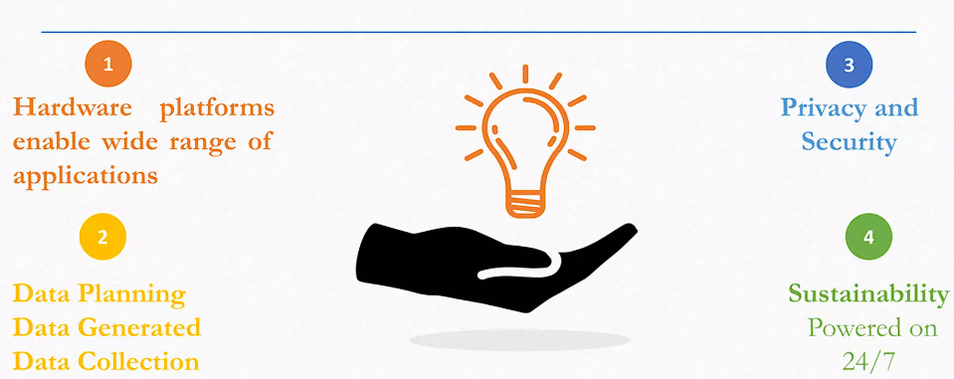
Challenges in IoT

Slide 16
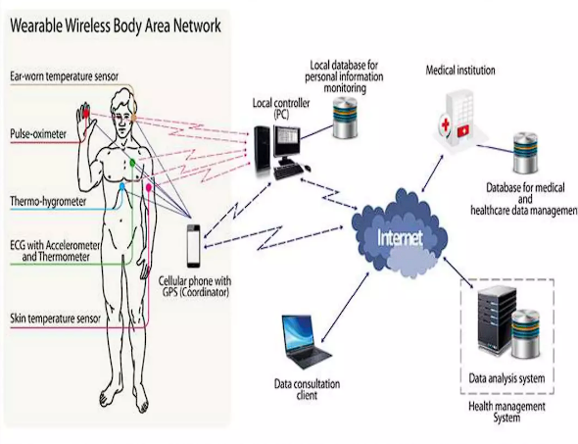
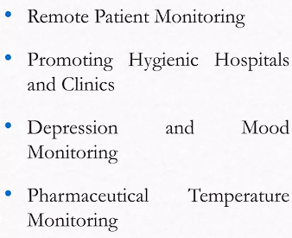
IoT in Health Care

Slide 17
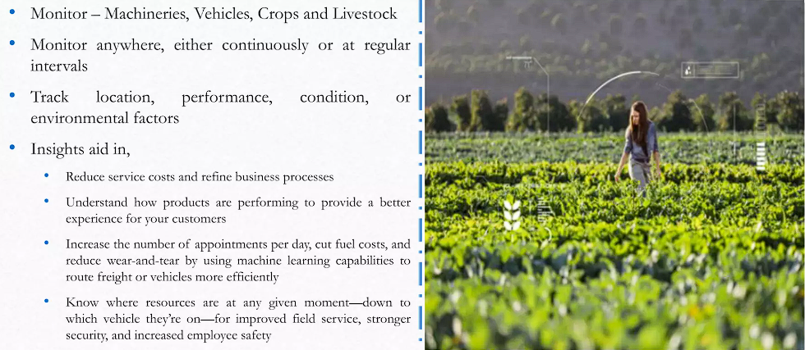
Remote Monitoring

Slide 18
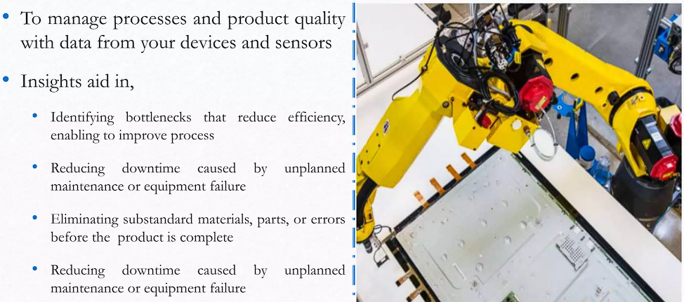
Manufacturing Efficiency

Slide 19
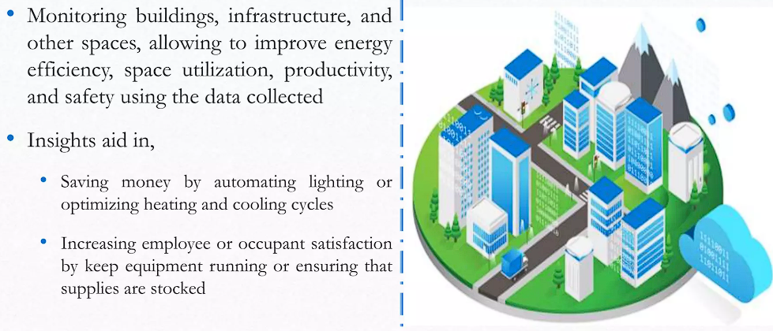
Challenges in IoT

Slide 20
Thank You !

